Slide 1

October 12, 2021
178.80
Game stop?
Jan 27
Sep 30
Group Project – Analytics for Unstructured Data
Ramya Desineedi, Neha Dipali, Prashanti Kodi, MC Kreps, Soumya Nayak, Shengxiang Wu
MSBA’22
The University of Texas at Austin

Slide 2
No changes in GameStop's fundamentals. Then why increase in price?
MIS 284N: Analytics for Unstructured Data
Dec 31 - $18.84
Jan 14 - $39.91
Jan 26 - $147.98
Jan 27 - $347.51
Jan 28 - $193.60
Jan 29 - $325.00
Robinhood suspends trading
Social Media
Anti- establishment
FOMO
Can social media sentiment be used as an indicator for stock price movement?
Notes:
Based on poor company fundamentals, hedge funds and other large investors were convinced that GameStop’s share price would decline. They bet against GameStop with large short positions. At the same time, thousands of small individual investors saw the opportunity to turn a profit by working against the investment establishment. Based on an idea discussed in WallStreetBets, a community on Reddit, thousands of individual investors made small investments in GameStop, knowing that eventually the short sellers would need to buy back the shares of GameStop – effectively creating a “short-squeeze.”
Driven by the demand from the individual investors as well as the fact that the Wall Street firms needed to cover their short sales, GameStop stock increased nearly 1500% at one point. GameStop’s case shows how powerful social media can be. When Robinhood, subject to additional capital requirements, had to temporarily block its customers from trading GameStop on their platform, the price of the stock dropped considerably. As soon as Robinhood re-enabled trading for GameStop, the stock changed course and its share price once again took off in a meteoric rise. Some of the upward pressure in price was driven by retail investors who were not part of the “short-squeeze,” but saw the escalating stock price and had a fear of missing out on its appreciation.
It is important to note that none of the recent volatility in GameStop stock is based on any material changes to the underlying fundamentals of the company.

Slide 3

methodology
MIS 284N: Analytics for Unstructured Data
Pre and Post Meme Stock Phase – Topic Modeling
Sentiments as indicator for stock price – Sentiment Analysis (VADER)
Future short-term outlook – Sentiment Analysis (VADER)
Jul-Sep’21
(Pre: Oct-Dec’20
Post: Jan-Mar’21)
Oct’21
Time Allocation
#GME
#GameStop
40k tweets scraped (SNScraper)
Tokenization, Stemming and Lemmatization
Topic Modeling
Sentiment Analysis
Data
Pre-Processing
Notes:
For this analysis, 40k tweets having “#GME” or “#GameStop” were scraped between Oct’20 and Oct’21 using SNScraper.
Our analysis covers the following 3 areas –
1. Pre-post analysis of GameStop becoming a meme stock: The time period considered for pre-meme-stock period is Oct’20 to Dec’20, and for the meme-stock period is between Jan’21 and Mar’21. Topic modeling will be used to identify dominant themes in the tweets.
2. We have considered the period of Jul’21 to Sep’21 to see if sentiments of the tweets can be used as an indicator for the stock price in the short term. This time period has been selected for 2 reasons –
a. Recency – The recent events are more relatable.
b. Volatility – Between Feb’21 and Mar’21, GameStop stock price had been highly volatile. The movement after June has been relatively smoother
3. Future outlook in the short term – Sentiment analysis cannot be a substitute for the fundamental analysis – it can be only used to capitalize the market imperfections in the short run.
While scraping the tweets consumed about 10% of the total time allocated, majority of the time was invested in cleaning the data and improving the data quality. There were multiple iterations to it – the biggest challenge included exclusion of the tweets concerned with inventory of the stores and had little to do with the stock price.
To clean the data and to get word frequency counts, we have used tokenization and played around with Stemming and Lemmatization. Topic Modeling (LDA) was used for identifying dominant themes, and the VADER package in Python was used for the sentiment analysis

Slide 4
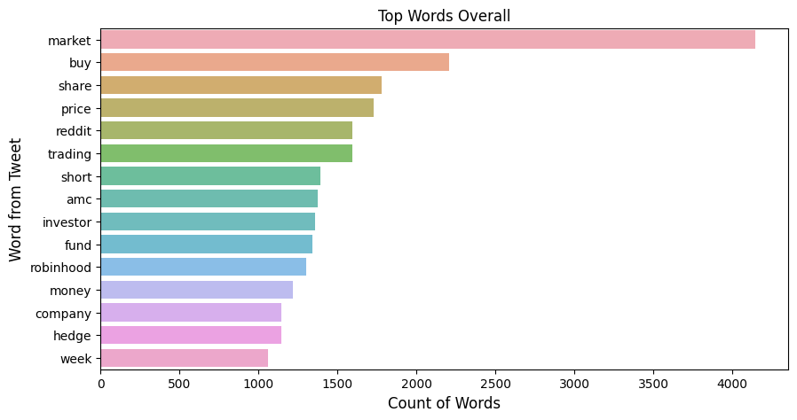
Exploratory data analysis
MIS 284N: Analytics for Unstructured Data
Removing punctuations, URL, Emoji
Flagging tweets with Products/ SKUs (consoles etc.)
Stop words removal, Lemmatization
 | Oct-Dec’20 | Jan-Mar’21 | Apr-Sep’21
Overvalued | 0.00020 | 0.00036 | 0.00036
Dogecoin | 0.00020 | 0.00043 | 0.00089
Robinhood | 0.00026 | 0.0146 | 0.00547
Stock Price | 0.00989 | 0.13138 | 0.06971
Wall Street | 0.00047 | 0.01474 | 0.00396
Word Frequency Count (Jan’21 – Mar’21)
Cosine Similarity
Notes:
Word Frequency Analysis + Cosine Similarity
SKU: We replaced 'Stock' with a meaning 'In stock' or 'Out of Stock' related tweets by 'Inventory'.
Most common words were found to be “short”, “AMC”, “Robinhood” and “hedge” indicating hedge funds
For Cosine Similarity, we compared different words such as 'Overvalued', 'Dodge Coin', 'Stock Price' to the 3 different periods as 3 different documents.
The method we used is bag of words. Based on the result, people are talking about gme stock price related topics more than before the frenzy period, but less than during the period.

Slide 5
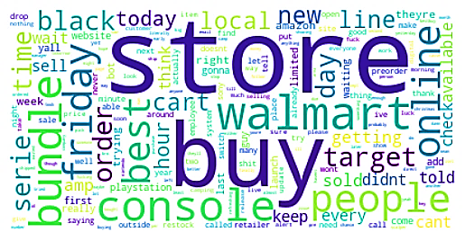
What were people discussing in oct-dec’20?
MIS 284N: Analytics for Unstructured Data
Gamestop Products
Retail competition
Common Topics
Notes:
Before GME became a meme stock, the Twitterati discussed mainly the business and store operations – 78% of the tweets scraped pertained to either the bundles and consoles (e.g. PS5, XBOX and Nintendo Switch), or the competitors (Walmart, Best Buy and Amazon).

Slide 6
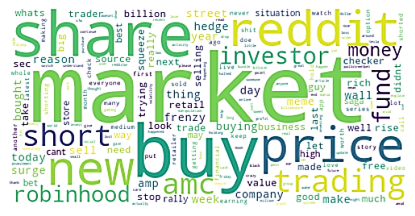
What were they talking about in jan-mar’21?
MIS 284N: Analytics for Unstructured Data
Common Topics
Market Players
Trading
SEC
Notes:
The most common themes between Jan and Mar’21 were found to be the market players – the billionaires, hedge funds (Wall street), retail investors; trading and the frenzy in general and the role that SEC played.

Slide 7
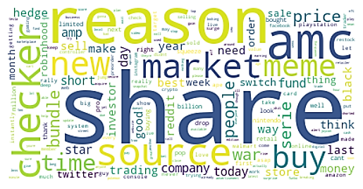
What were the THEMES APR’21 ONWARDS?
MIS 284N: Analytics for Unstructured Data
Market Frenzy
Product
Common Topics
Notes:
From Apr’21 onwards the most common topics discussed were found to be the market frenzy and products in the stores.

Slide 8





Can Sentiments Indicate Direction of Stock Price Movement?
MIS 284N: Analytics for Unstructured Data
10,000 Tweets
(Jul-Sep’21)
Data Cleaning
Stop words
Special characters
Emojis
User mentions
Hyperlinks
Deduplication and Filtering out irrelevant tweets
Sentiment Analysis (VADER) – direction of compound sentiment
Comparison of day sentiment with stock price movement
Escape sequences
Notes:
We studied 10k tweets between July and September 2021. After cleaning the data and removing irrelevant tweets, we analysed the general sentiment for each day and compared it with the stock movement trend the following day.
We ran another iteration of sentiment analysis after removing all the irrelevant tweets (pertaining to different products)

Slide 9
How did our logic perform?
MIS 284N: Analytics for Unstructured Data
Assumption: Tweet sentiment reflected in next day’s stock movement direction
Iteration 1:
Considering all tweets
Accuracy – 40 of 92 days
(43% of occasions)
Iteration 2:
Removing unrelated tweets
Accuracy – 52 of 92 days
(57% of occasions)
Trending Topic Effect
Scope for more data cleaning!
Unsuitable for longer investment horizon
Notes:
Direction of compound sentiment (1 or -1) averaged for each day. Considering the direction of the averages. For example, if there are 100 tweets on a Tuesday, with 60 of them having positive compound score and 40 of them having negative compound score, then we have the day sentiment as {60*1 + 40*(-1)} = +20 -> As day sentiment > 0, we say direction of day sentiment = 1 (else, it would have been -1)
For the stock prices, we consider the difference in the closing prices. In this case, we look for the impact on Tuesday’s tweets on the direction of movement on Wednesday. If price(Wednesday) > price(Tuesday) then direction of stock = 1 (in the converse case it would have been -1)
For accuracy, we consider the number of times the direction of day sentiment was equal to the direction of the stock movement in the 92-day period.
Insights:
- Trending Topic Effect – people using #GME even though their post isn’t relevant
- Accuracy improves after removing unrelated tweets. Scope for more data cleaning!
- Can be used to capitalize on short term market imperfections. Not suitable for long term investing

Slide 10
Short term outlook
MIS 284N: Analytics for Unstructured Data
Dismal fundamentals
in FY21 Q2 (Sep’21 end)
Loss of $0.77/share:
higher than anticipation
“Dead Business Model” with strong competition – will become a dinosaur unless they innovate
Data:
Oct 1 to Oct 11
Generally negative sentiment observed for ALL 11 days
Notes:
GameStop has dismal fundamentals and a dead business model, and the hedge funds were not wrong in shorting the stock based on the fundamentals. In FY21 Q2 results posted in late September, GameStop had a loss of 77c/share, which was much times worse than what most analysts had predicted. Considering the dead business model and the strong competition, GameStop is sure to become a dinosaur unless they innovate big quickly.
This is supported by the immediate Twitter sentiment trend too – in the data taken for Oct 1 to Oct 11, we observed a negative sentiment in ALL 11 days!
Moral of the story: Invest (or should I say TRADE) at your own risk! Sentiment analysis can bring value in VERY short timeframes (1-2 weeks)!

Slide 11

Short term outlook
MIS 284N: Analytics for Unstructured Data
Thank You!
Notes:
Need to work on this!

